Slide 1
Final Project
Blue Team -
Luis Acevedo, David Lago, Susana Correia,
Zarneisha Browning, Maurice Beckford.

Slide 2
The Purpose of the Analysis
For this group project we choose to analyse Covid-19 data. After cleaning and analysing the data used right from CDC website, the group have decided to answer the following question:
Based on age, how likely are you to survive Covid-19?

Slide 3
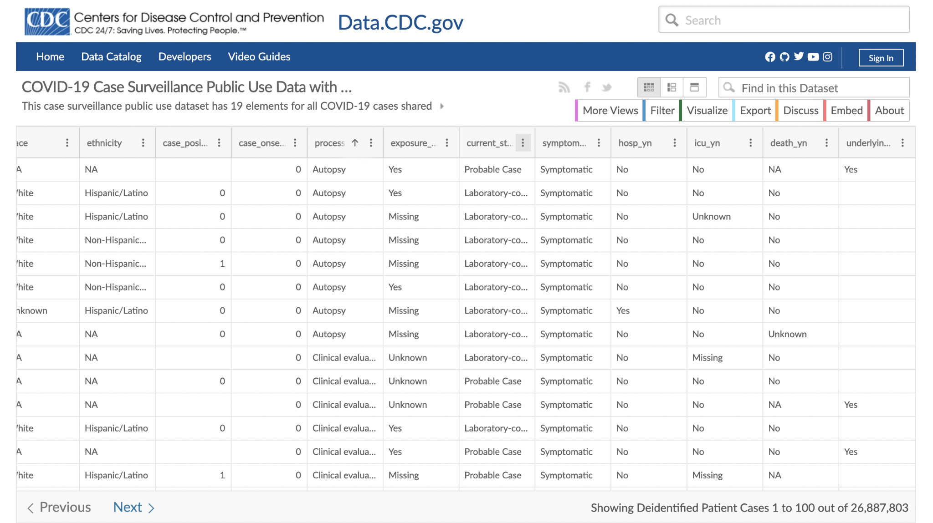
Raw Data from Data.CDC.gov

Slide 4
Work as a Team - Roles
The group have been discussing together which technologies will be used for each step of the project.
Zarneisha suggested the Covid-19 topic, and the group decided to get the data from CDC website;
Luis cleaned the data which started with xx columns and more than 26 million rows down to two columns and xx rows.
David created the Github Repository, and started writing on the Readme file.
Maurice added more to the Readme file;
Zarneisha created the machine learning model;
David has also created a machine learning model for us to compare results;
Susana has been putting the presentation together, and worked with Tableau to have the data visualization.

Slide 5
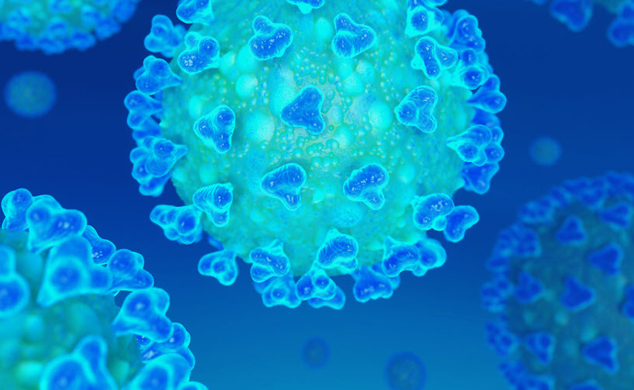
Age Groups X Covid-19 Death
0 - 17 years
18 - 49 years
50 - 64 years
65 + years
X

